Slide 1
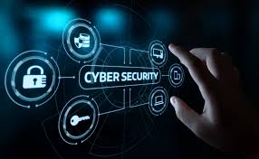

Slide 2
Introduction

Slide 3
Why are we talking about cybersecurity?

Slide 4
Case 1: Internet under siege
February 7 – 9, 2000 Yahoo!, Amazon, Buy.com, CNN.com, eBay, E*Trade, ZDNet websites hit with massive denial of service (DOS)
U.S. Federal Bureau of Investigation (FBI) officials have estimated that the attacks caused $1.7 billion in damage

Slide 5
Case 2: Slammer worm
January 2003 Infects 90% of vulnerable computers within 10 minutes
Effect of the worm
o Interference with elections
o Cancelled airline flights
o 911 emergency systems affected in Seattle
o 3 000 Bank of America ATMs failed
No malicious payload!
Estimated $1 billion in productivity loss

Slide 6
Case 3: September 11
Wireless tower on top of Trade Center destroyed
AT&T has record call volumes
‘Flash’ usage severely limits availability
Rescue efforts hampered

Slide 7
Cybersecurity perspective
Many aspects of our lives rely on the Internet and computers
Consider how much of your personal information is stored either on your own computer or on someone else’s system.
How is that data, and the systems on which that data resides (or is transmitted), kept secure?

Slide 8
Information security vs cybersecurity
the aim of information security is to ensure business continuity and minimise business damage by limiting the impact of security incidents (Von Solms, 1998).
Whitman and Mattord (2009) define information security as “the protection of information and its critical elements, including the systems and hardware that use, store, and transmit that information” (Whitman and Mattord, 2009, p. 8).
Von Solms et al (2013) argue that cybersecurity goes beyond the boundaries of traditional information security to include not only the protection of information resources, but also that of other assets, including the person him/herself.

Slide 9
Information security vs cybersecurity
According to H.R. 4246 ‘Cybersecurity Information Act’, cybersecurity is:
“The vulnerability of any computing system, software program, or critical infrastructure to, or their ability to resist, intentional interference, compromise, or incapacitation through the misuse of, or by unauthorized means of, the Internet, public or private telecommunications systems or other similar conduct that violates Federal, State, or international law, that harms interstate commerce of the United States, or that threatens public health or safety.”

Slide 10
Information security vs cybersecurity
Cybersecurity can also be defined as: “Protection of information systems against unauthorized access to or modification of information, whether in storage, processing or transit, and against the denial of service to authorized users, including those measures necessary to detect, document, and counter such threats.”
“Cyber security is the body of technologies, processes and practices designed to protect networks, computers, programs and data from attack, damage or unauthorized access”
(http://whatis.techtarget.com/definition/cybersecurity)

Slide 11

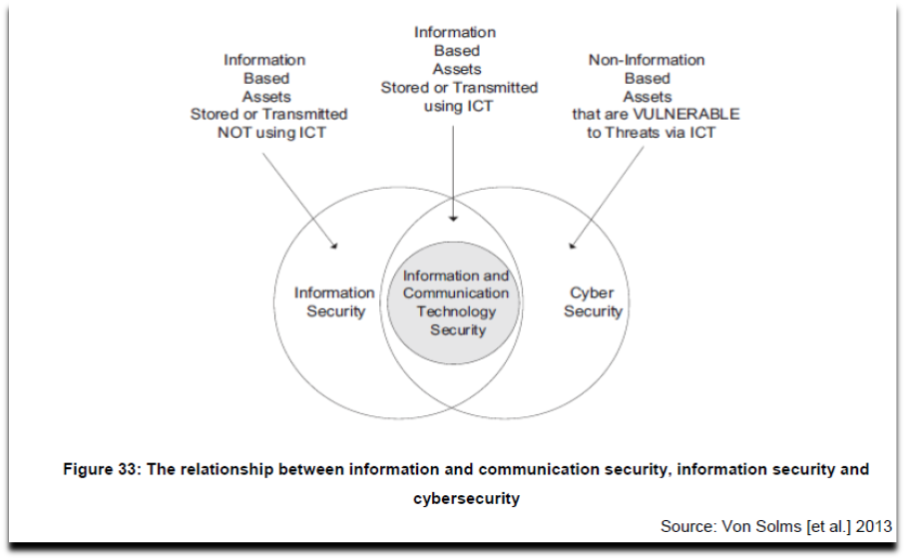
Relationship between information security and cyber security

Slide 12
Principles of cyber security
Confidentiality: Information which is sensitive or confidential must remain so and be shared only with appropriate users.
Integrity: Information must retain its integrity and not be altered from its original state.
Availability: Information and systems must be available to those who need it/them.

Slide 13
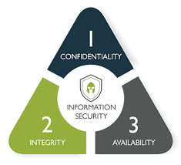
C.I.A. triangle

Slide 14
C.I.A. triangle
Confidentiality: Information which is sensitive or confidential must remain so and be shared only with appropriate users.
Integrity: Information must retain its integrity and not be altered from its original state.
Availability: Information and systems must be available to those who need it/them.

Slide 15
Why cybersecurity is important
The increasing volume and sophistication of cybersecurity threats – including targeting phishing scams, data theft and other online vulnerabilities – demand that we remain vigilant about securing our systems and information.
The average unprotected computer (i.e. does not have proper security controls in place) connected to the Internet can be compromised in moments. Thousands of infected web pages are being discovered every day. Hundreds of millions of records have been involved in data breaches. New attack methods are launched continuously. These are just a few examples of the threats facing us, and they highlight the importance of information security as a necessary approach to protecting data and systems.

Slide 16
How can you protect yourself or organisation against cyber-threats?
Properly configure and patch operating systems, browsers and other software programs.
Use and regularly update firewalls, anti-virus and anti-spyware programs.
Use strong passwords (combination of upper and lower-case letters, numbers and special characters), and do not share passwords.
Be cautious about all communications; think before you click. Use common sense when communicating with users you do and do not know.
Do not open e-mail or related attachments from untrusted sources.
Allow access to systems and data to only those who need it, and protect those access credentials.
Follow your organisation’s cybersecurity policies, and report violations and issues when they occur

Slide 17
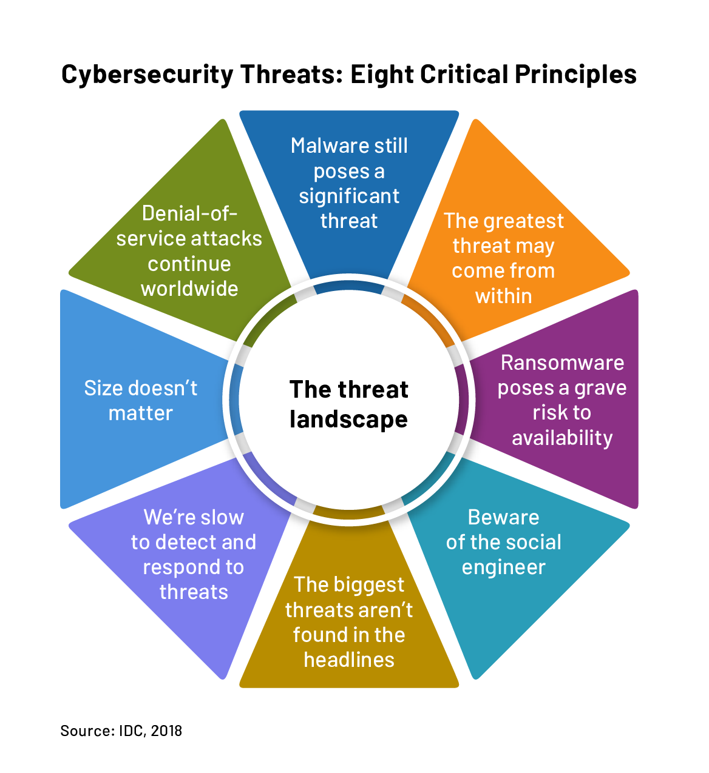
Cybersecurity risks/threats

Slide 18
Cyber bullying
According to Martin and Rice (2011), several recent studies have found that technology is increasingly used to bully, “cause embarrassment, invoke harassment and violence, and inflict psychological harm”. This could lead to “severe and negative impacts on those victimized”.

Slide 19
Cyber terrorism
Critical infrastructure is defined as “the assets, systems, and networks, whether physical or virtual, so vital to the United States that their incapacitation or destruction would have a debilitating effect on security, national economic security, public health or safety, or any combination thereof” (Department of Homeland Security, 2011).
Cyber-terrorists or enemy specialists may target a country’s critical infrastructure via cyberspace. This could either be indirectly, for example by influencing the availability of information services using denial-of-service attacks or, more directly, through an attack on the national electricity grid.

Slide 20
Cyber espionage
Cyber espionage is an act of gaining unauthorized network or system access, usually to obtain the sensitive data of a government or a military infrastructure using proxy servers.
This notorious practice is an attempt to damage or misuse compromised data, which usually refers to political, economic, or military data. In the world of cyber espionage, the threat actors are generally either state-affiliated actors or nation-states with the motive of strategic advantage.

Slide 21
Denial-of-service
This refers to an attack that successfully prevents or impairs the authorised functionality of networks, systems or applications by exhausting resources. What impact could a denial-of-service have if it shut down a government agency’s website, thereby preventing citizens from accessing information or completing transactions?

Slide 22
Malware, worms and Trojan horses
Malware is a term used to describe malicious software, including spyware, ransomware, viruses, and worms. Malware breaches a network through a vulnerability, typically when a user clicks a dangerous link or email attachment that then installs risky software.

Slide 23
Phishing
Phishing is the practice of sending fraudulent communications that appear to come from a reputable source, usually through email. The goal is to steal sensitive data like credit card and login information or to install malware on the victim’s machine. Phishing is an increasingly common cyberthreat.

Slide 24
DNS Tunneling
DNS tunneling utilizes the DNS protocol to communicate non-DNS traffic over port 53. It sends HTTP and other protocol traffic over DNS. There are various, legitimate reasons to utilize DNS tunneling. However, there are also malicious reasons to use DNS Tunneling VPN services. They can be used to disguise outbound traffic as DNS, concealing data that is typically shared through an internet connection. For malicious use, DNS requests are manipulated to exfiltrate data from a compromised system to the attacker’s infrastructure. It can also be used for command and control callbacks from the attacker’s infrastructure to a compromised system.

Slide 25
Botnets and zombies
A botnet, short for ‘robot network’, is an aggregation of compromised computers that are connected to a central ‘controller’. The compromised computers are often referred to as ‘zombies’
Botnets designed to steal data are improving their encryption capabilities and thus becoming more difficult to detect

Slide 26
Scareware’ – fake security software warnings
This type of scam can be particularly profitable for cyber criminals, as many users believe the pop-up warnings telling them their system is infected and are lured into downloading and paying for the special software to ‘protect’ their system

Slide 27
Penetration testing
A penetration test, sometimes ‘pentest’, is a software attack on a computer system that looks for security weaknesses, potentially gaining access to the computer's features and data. It is a proactive and authorised attempt to evaluate the security of an IT infrastructure by safely attempting to exploit system vulnerabilities, including OS, service and application flaws, improper configurations, and even risky end-user behaviour

Slide 28
Why perform penetration testing?
1. Security breaches and service interruptions are costly
2. It is impossible to safeguard all information, all the time
3. Penetration testing identifies and prioritises security risks

Slide 29
Why perform penetration testing?
4. To find vulnerabilities and fix them before an attacker does
5. Find holes now before somebody else does
6. Report problems to management
7. Verify secure configurations

Slide 30
Why perform penetration testing?
8. Security training for network staff
9. Discover gaps in compliance
10. Testing new technology

Slide 31
How often should you perform penetration testing?
Penetration testing should be performed on a regular basis to ensure more consistent IT and network security management by revealing how newly discovered threats or emerging vulnerabilities may potentially be assailed by attackers.

Slide 32
How can you benefit from penetration testing?
Intelligently manage vulnerabilities: Penetration testing provides detailed information on actual, exploitable security threats. By performing a penetration test, you can proactively identify which vulnerabilities are most critical, which are less significant, and which are false positives.
Avoid the cost of network downtime: Recovering from a security breach can cost an organisation millions of dollars related to IT remediation efforts, customer protection and retention programmes, legal activities, discouraged business partners, lowered employee productivity and reduced revenue.
Meet regulatory requirements and avoid fines: Penetration testing helps organisations address the general auditing/compliance aspects.

Slide 33
How can you benefit from penetration testing
Even a single incident of compromised customer data can be costly in terms of both negatively affecting sales and tarnishing an organisation’s public image. With customer retention costs higher than ever, no one wants to lose the loyal users that they have worked hard to earn, and data breaches are likely to turn off new clients. Penetration testing helps you avoid data incidents that put your organisation’s reputation and trustworthiness at stake.

Slide 34
Penetrating testing tools
Metasploit
Nessus vulnerability scanner
Nmap
Burp suite
OWASP ZAP
SQLmap
Kali Linux
Jawfish

Slide 35
Conclusion
Cybersecurity is an inter-disciplinary field, and success depends on many factors, including technology, economics, usability and psychology. Cybersecurity is perhaps the most difficult intellectual profession on the planet. Due to the pace of technological change and broader developments in threats in the online environment, it is necessary to undertake ongoing evaluation and regular reviews of the appropriateness of an organisation’s cybersecurity policies. It is also important that enough time and resources be dedicated to finding cybersecurity threats and solutions, and that preventive steps are taken to circumvent these threats

